Slide 1

DSCI 6015 AI&CyberSecurity MID-TERM PROJECT
PROJECT BY
Suneel Kumar

Slide 2
TASK
Deploying Cloud-based PE Malware Detection API That Classifies
Malware and Beningn files From The Ember DataSet

Slide 3


Slide 4


Slide 5
STEPS
Training &Implementation
Deploying our model on the cloud
Creating a client

Slide 6
Step 1:
Jupyter Notebook
Model Training
Evaluation
Validation
Metrics

Slide 7
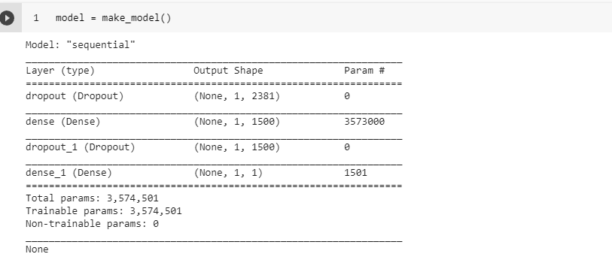
Model Architecture

Slide 8
STEP 2 :
Note Book Instance
Jupyter Notebook
S3 Bucket
Aws Sage Maker

Slide 9
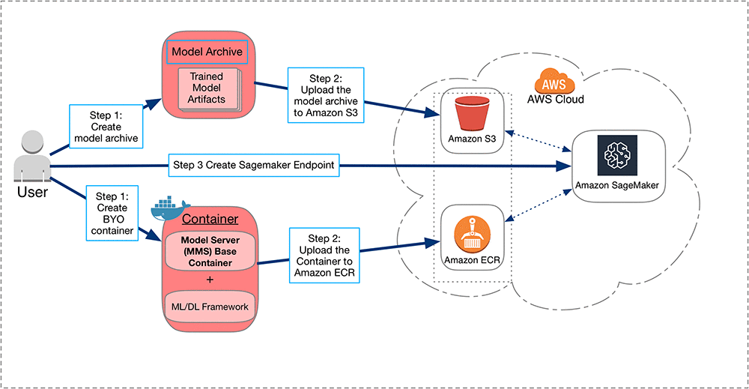
AWS SAGEMAKER OVERVIEW

Slide 10
Step 3 :
Launch Virtual Machine With an OS on it
Install Python
Move necessary files
Make a python Script in a Text Editor

Slide 11
